Slide 1
Introduction to Computing for Data Analysis
Does my (numerical) program compute the right answer?
Richard Vuduc, Ph.D.
Associate Professor
School of Computational Science and Engineering
Points that “float”
Notes:
Hola, amigos.
The goal of this lesson is to refine our notion of how to store fractional values on a computer by introducing the concept of “floating-point” storage.
This concept is the basis of how real numbers are stored and manipulated on almost any computer you can access today.

Slide 2
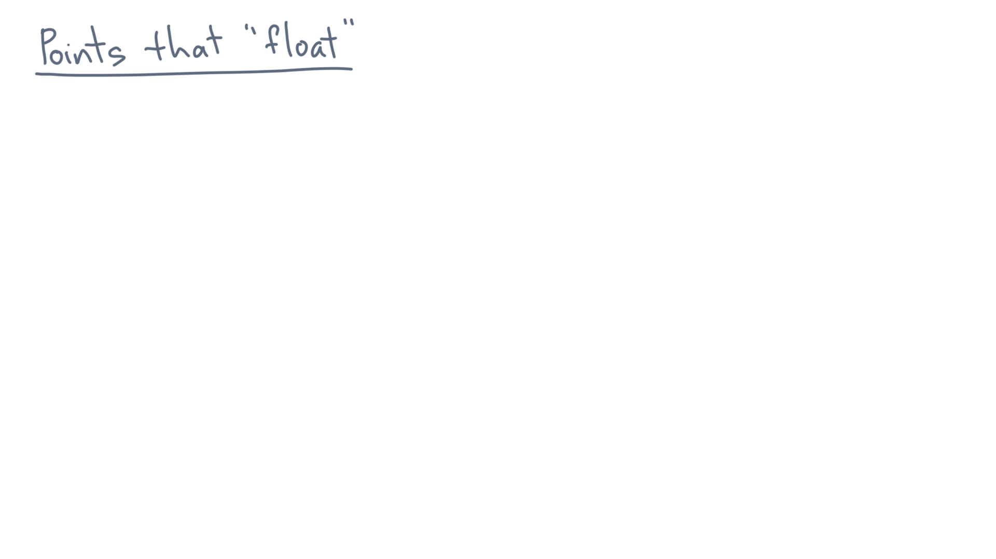
Notes:
Let’s define, intuitively, the concept of a “floating-point” representation of a number.

Slide 3
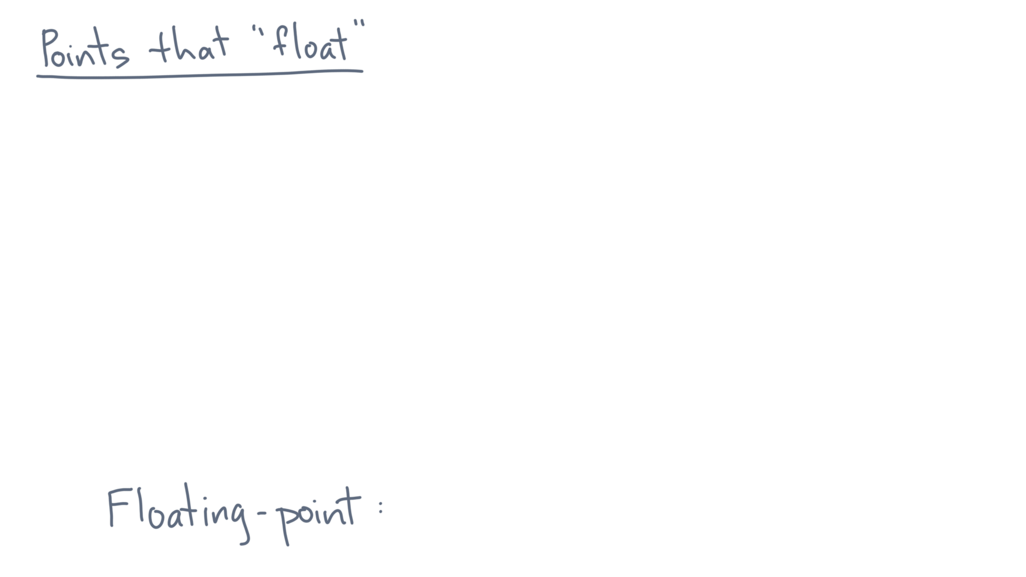
Notes:
Remember that you can think of a number as its string representation.

Slide 4
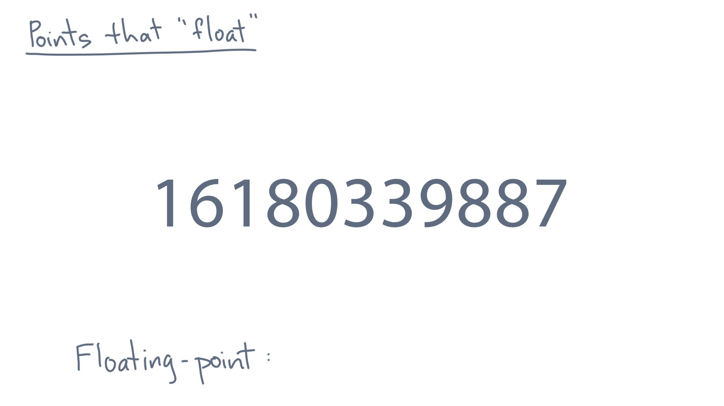
Notes:
Let’s further suppose that the maximum number of digits you are allowed to use to store the number is *fixed*.

Slide 5
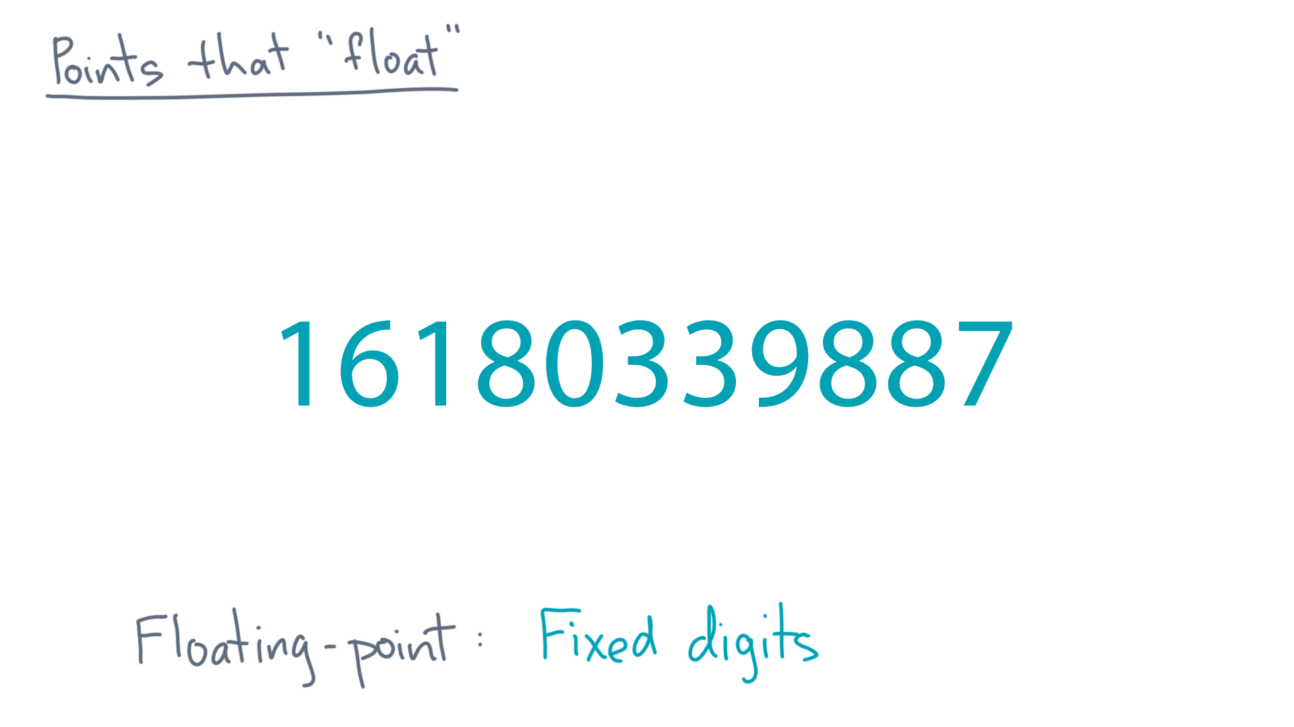
Notes:
In this example, let’s say we are only allowed to use 11 positions to store any number.
This particular number uses all 11 slots.

Slide 6
Notes:
What if we also want to represent fractional values without using additional positions?

Slide 7
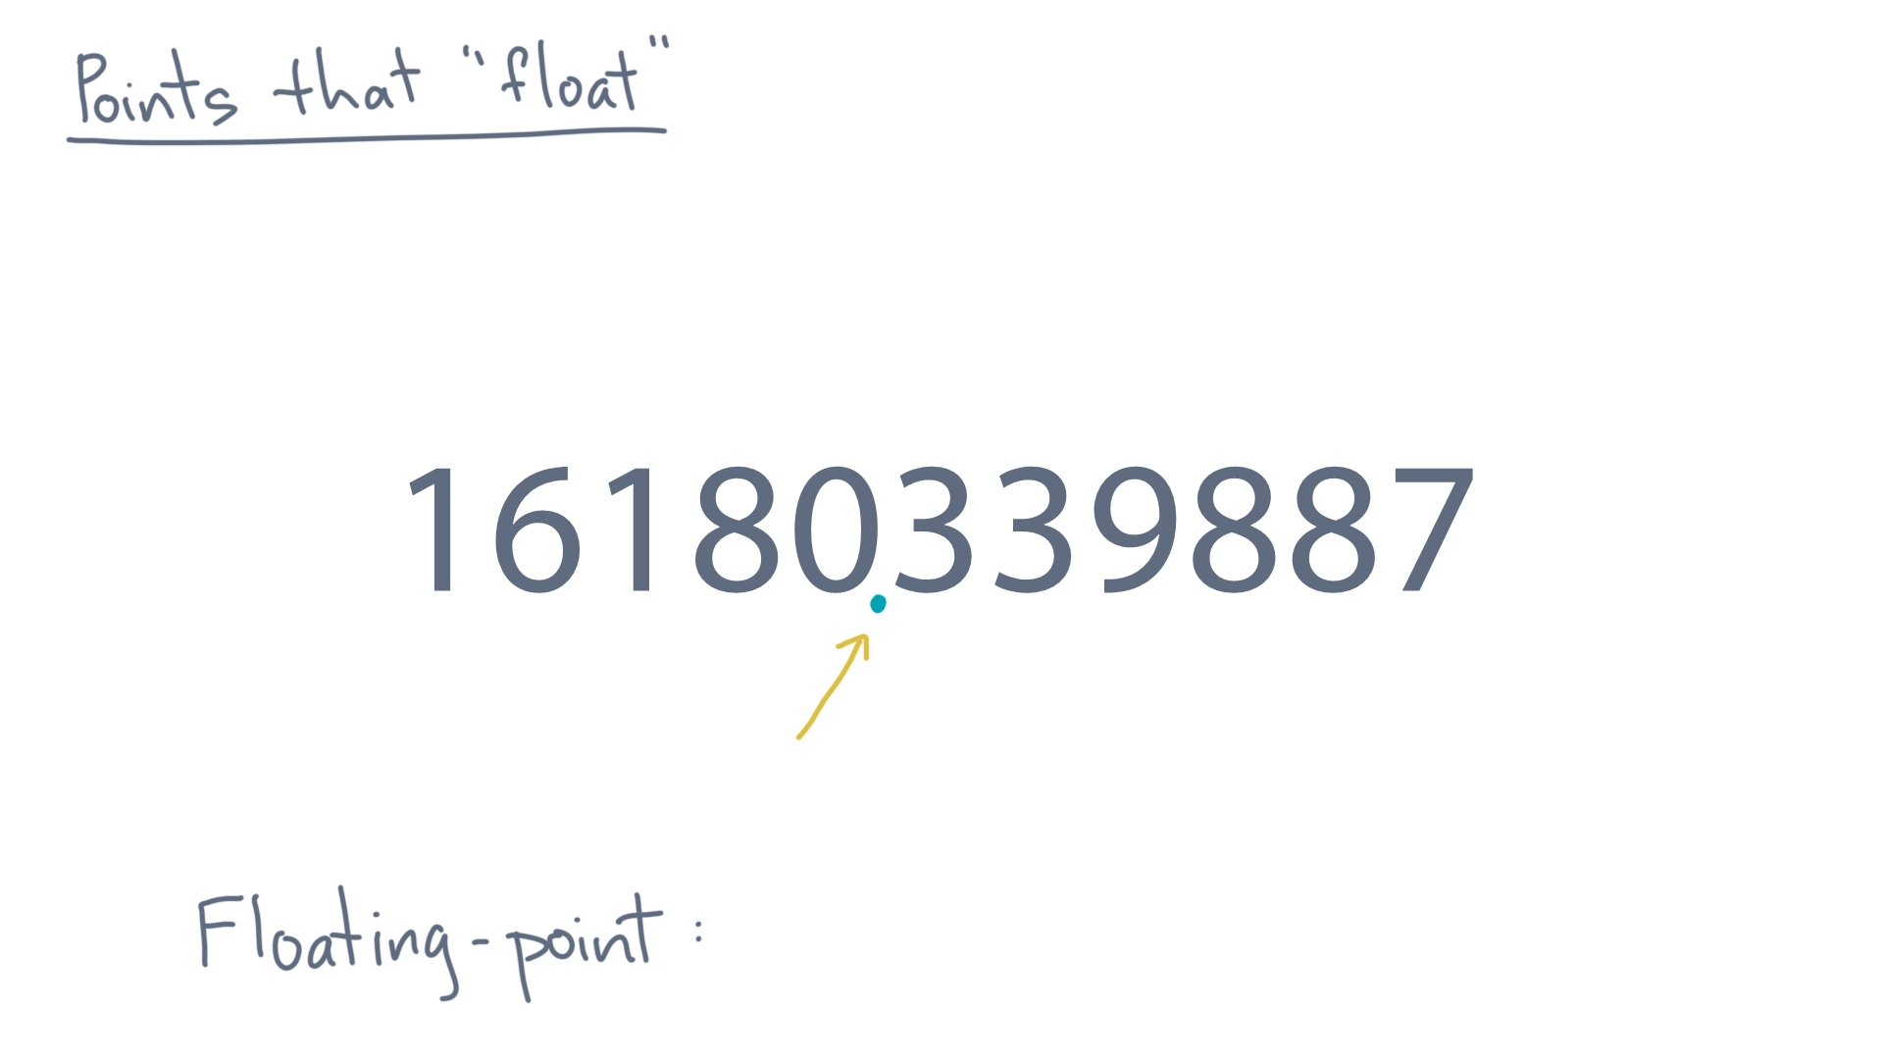
Notes:
Take this number for instance.

Slide 8
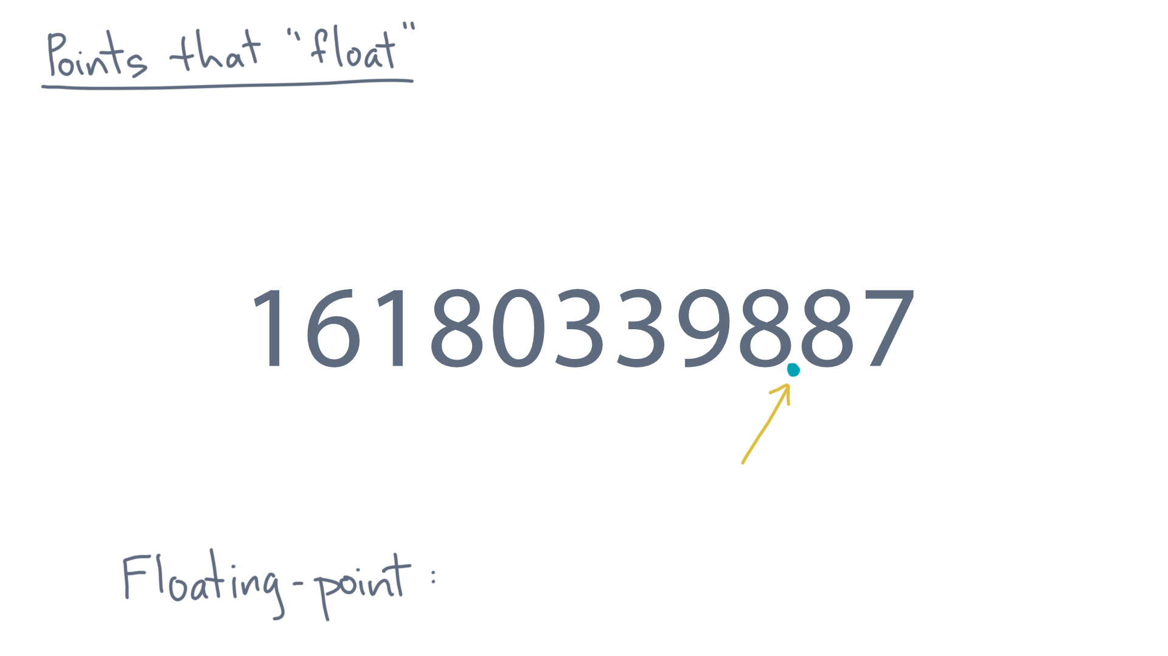
Notes:
Or maybe this one.

Slide 9
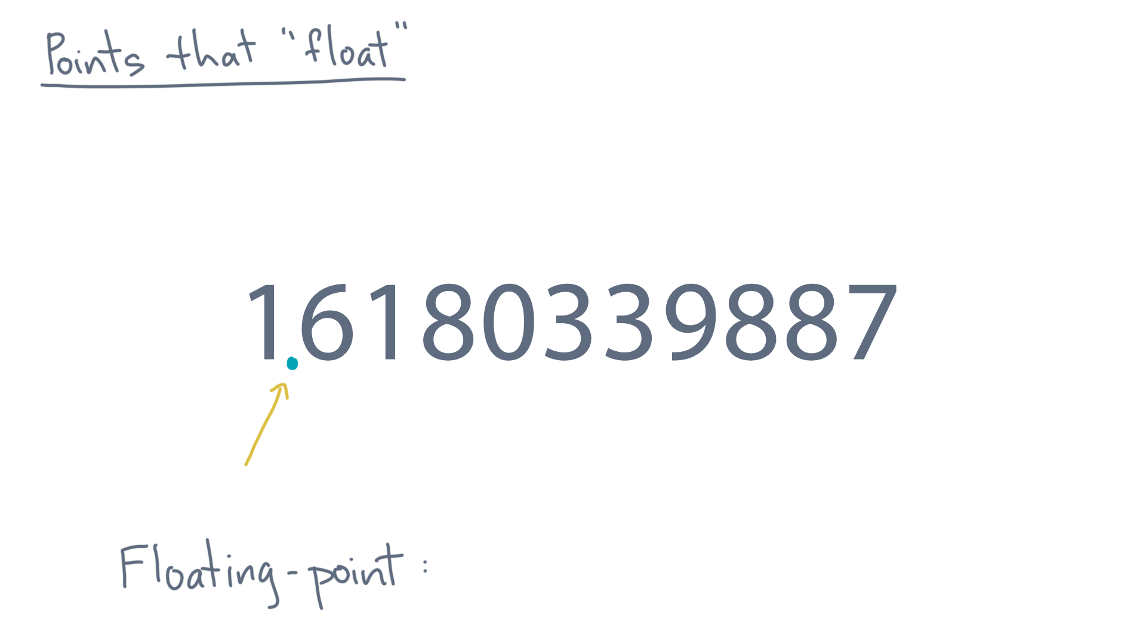
Notes:
Or what about this one?

Slide 10
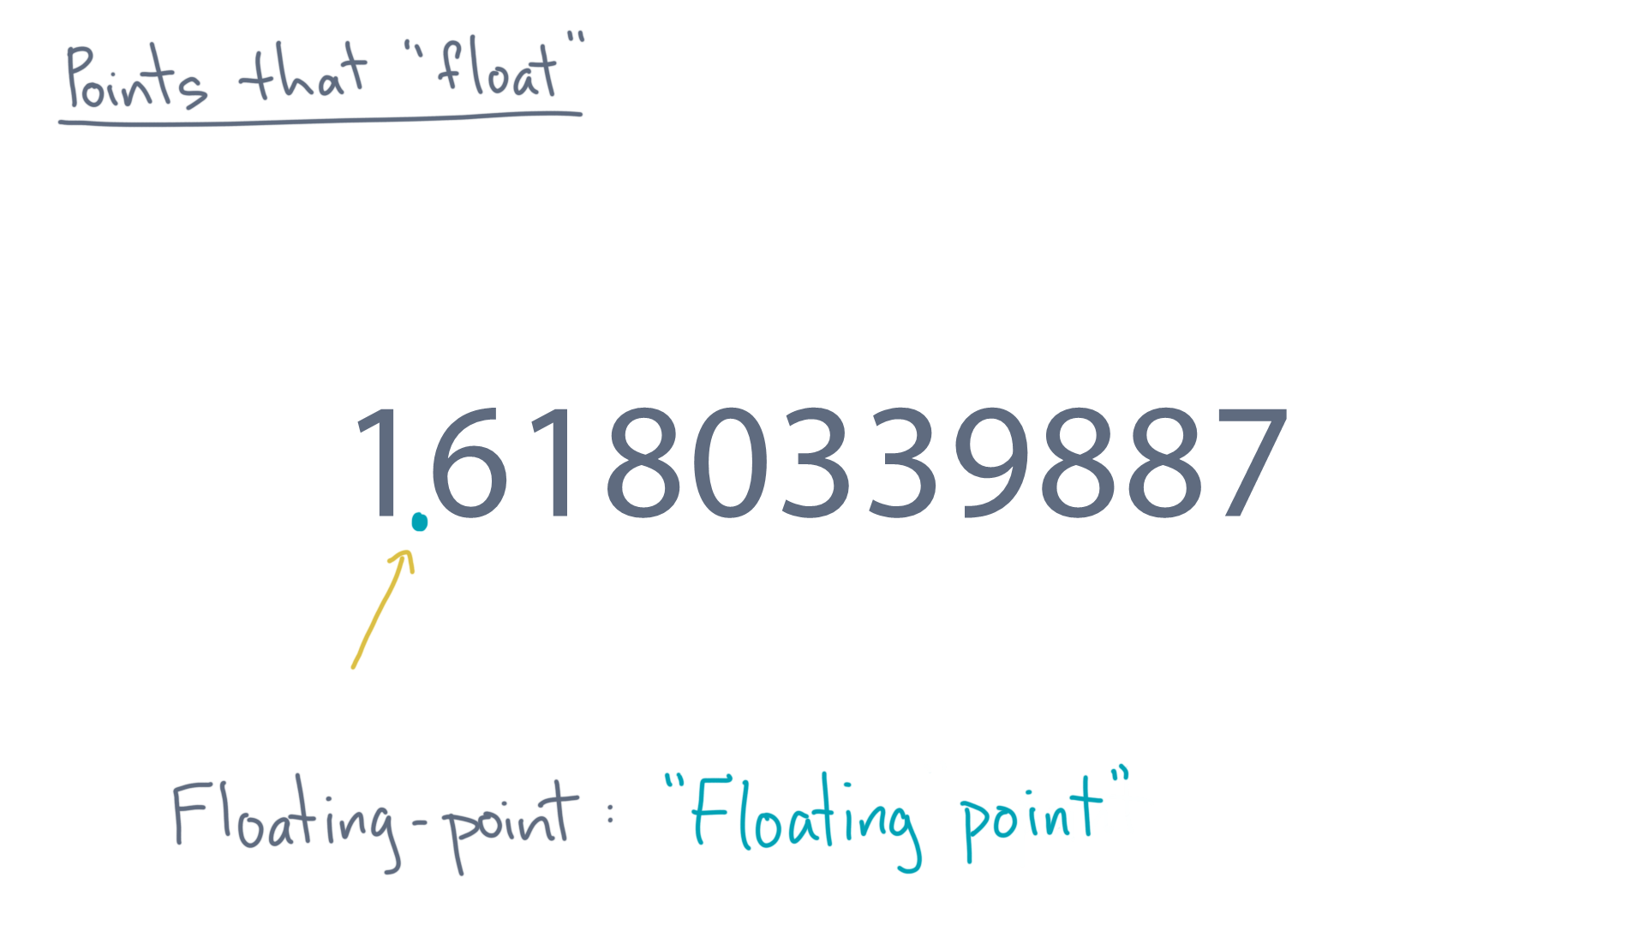
Notes:
With a fixed number of digits, let’s allow the decimal point to move as needed to represent different fractional numbers.

Slide 11
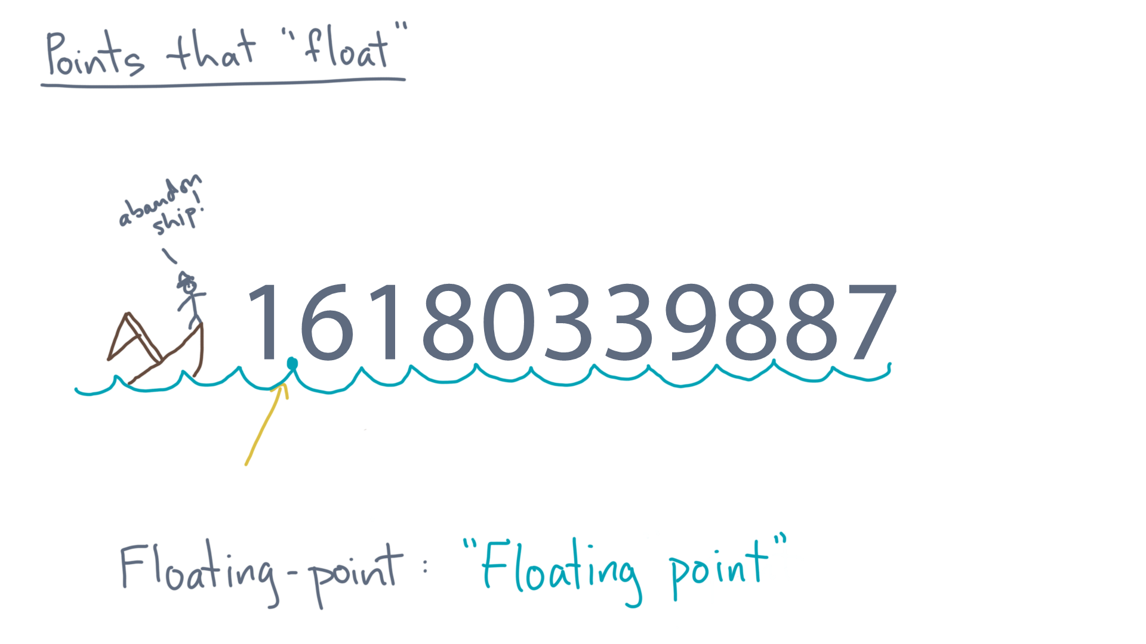
Notes:
That is, let’s allow the decimal point to “float” between digits.

Slide 12
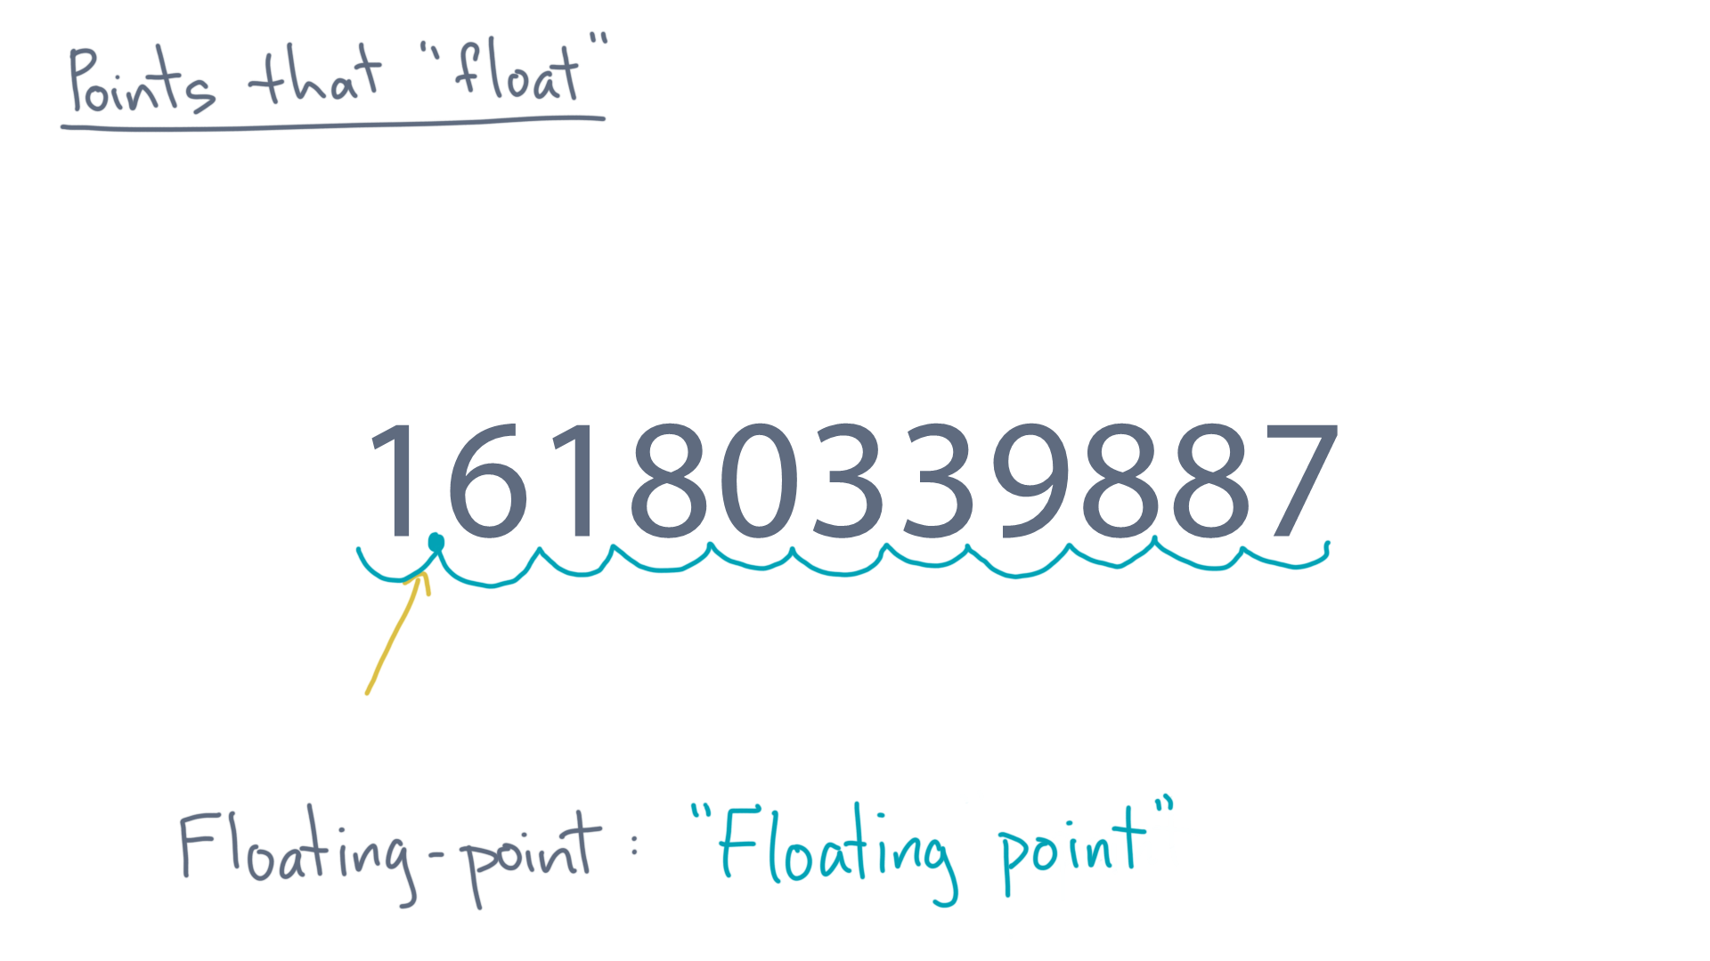
Notes:
This idea implies that we room to store the digits, *plus* something to tell us where the fraction starts.

Slide 13
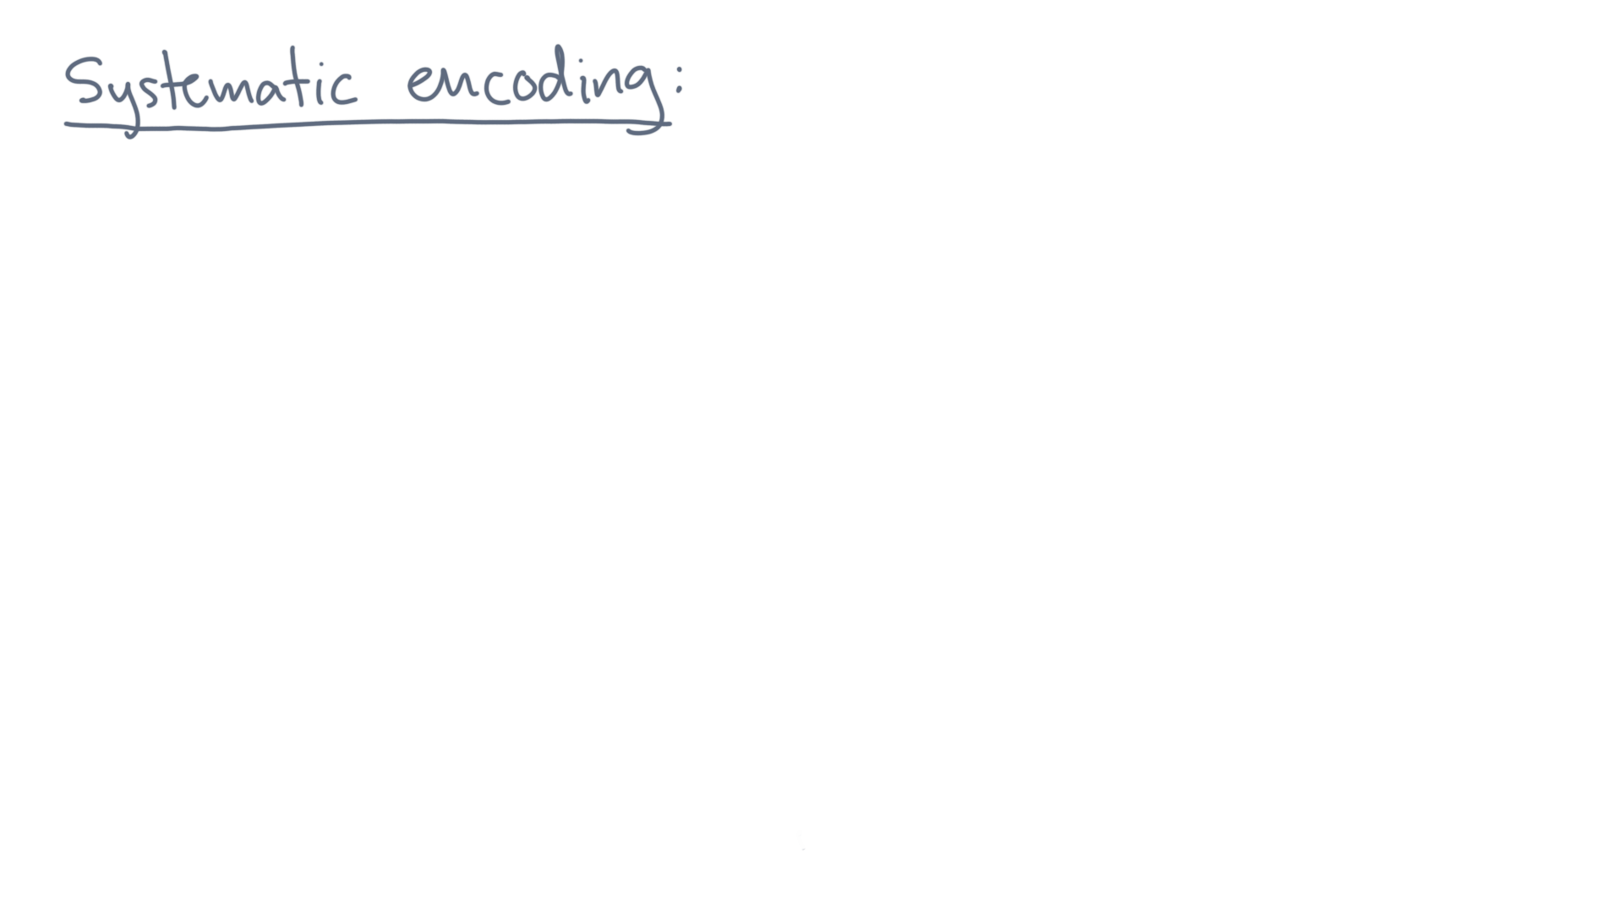
Notes:
So let’s talk about one way to do that systematically.

Slide 14
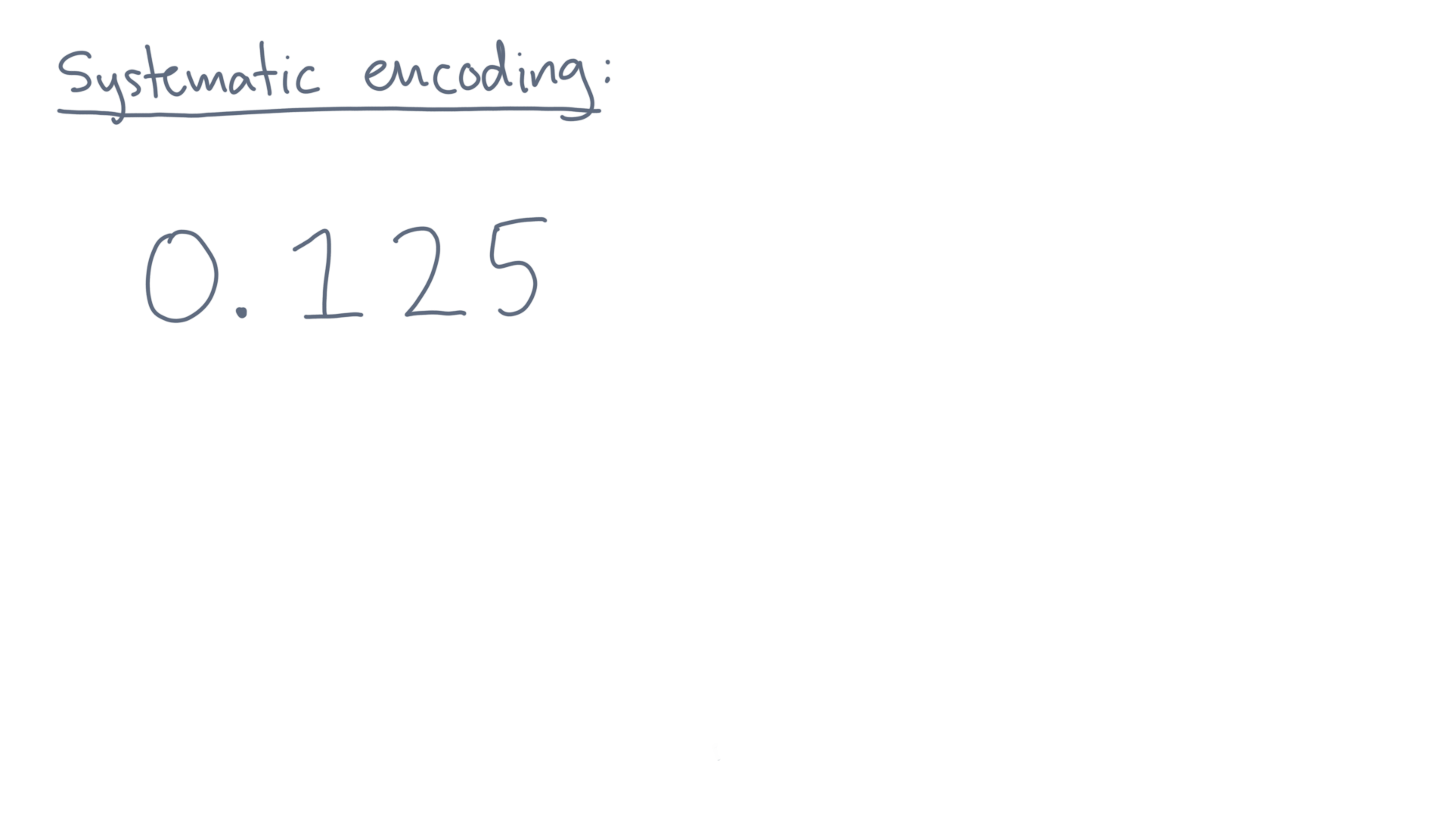
Notes:
Consider any value, like this one, 0.125.
A systematic way to write such a number is to use *scientific notation*.

Slide 15
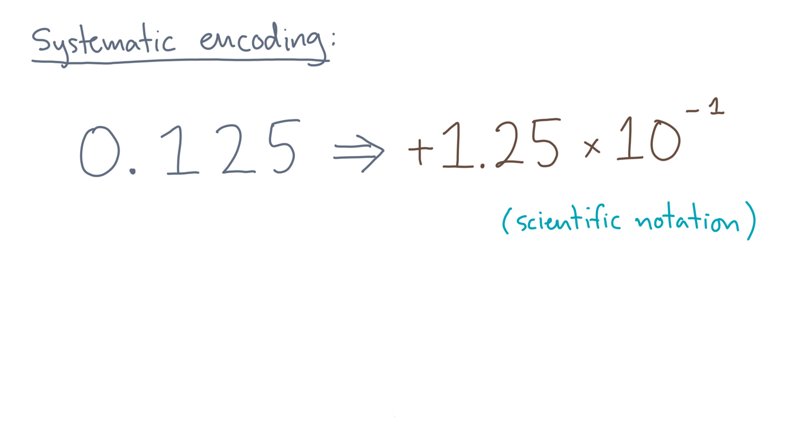
Notes:
In this case, positive 1.25 times ten to the minus 1.
The number has three components.

Slide 16
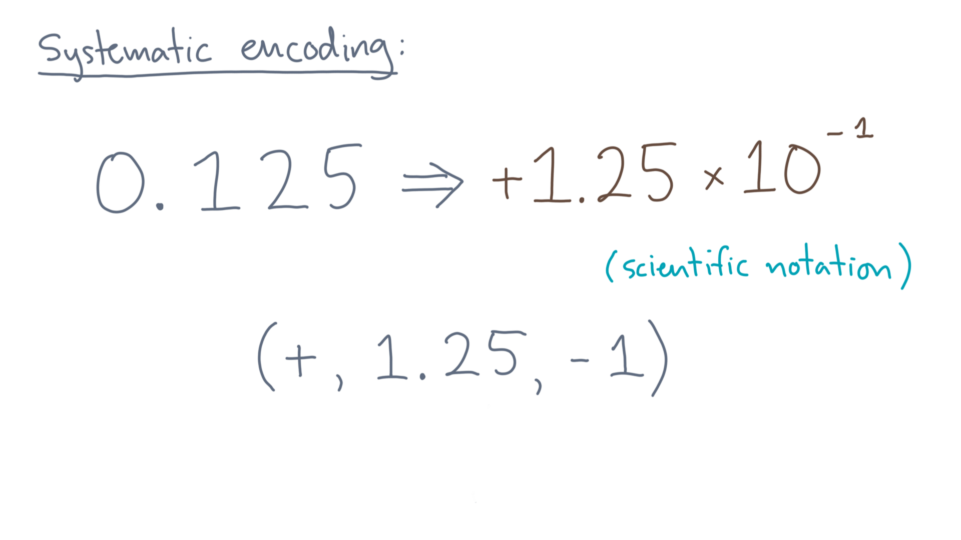
Notes:
You can think of them as the elements of a tuple.
There’s the sign, plus or minus.

Slide 17
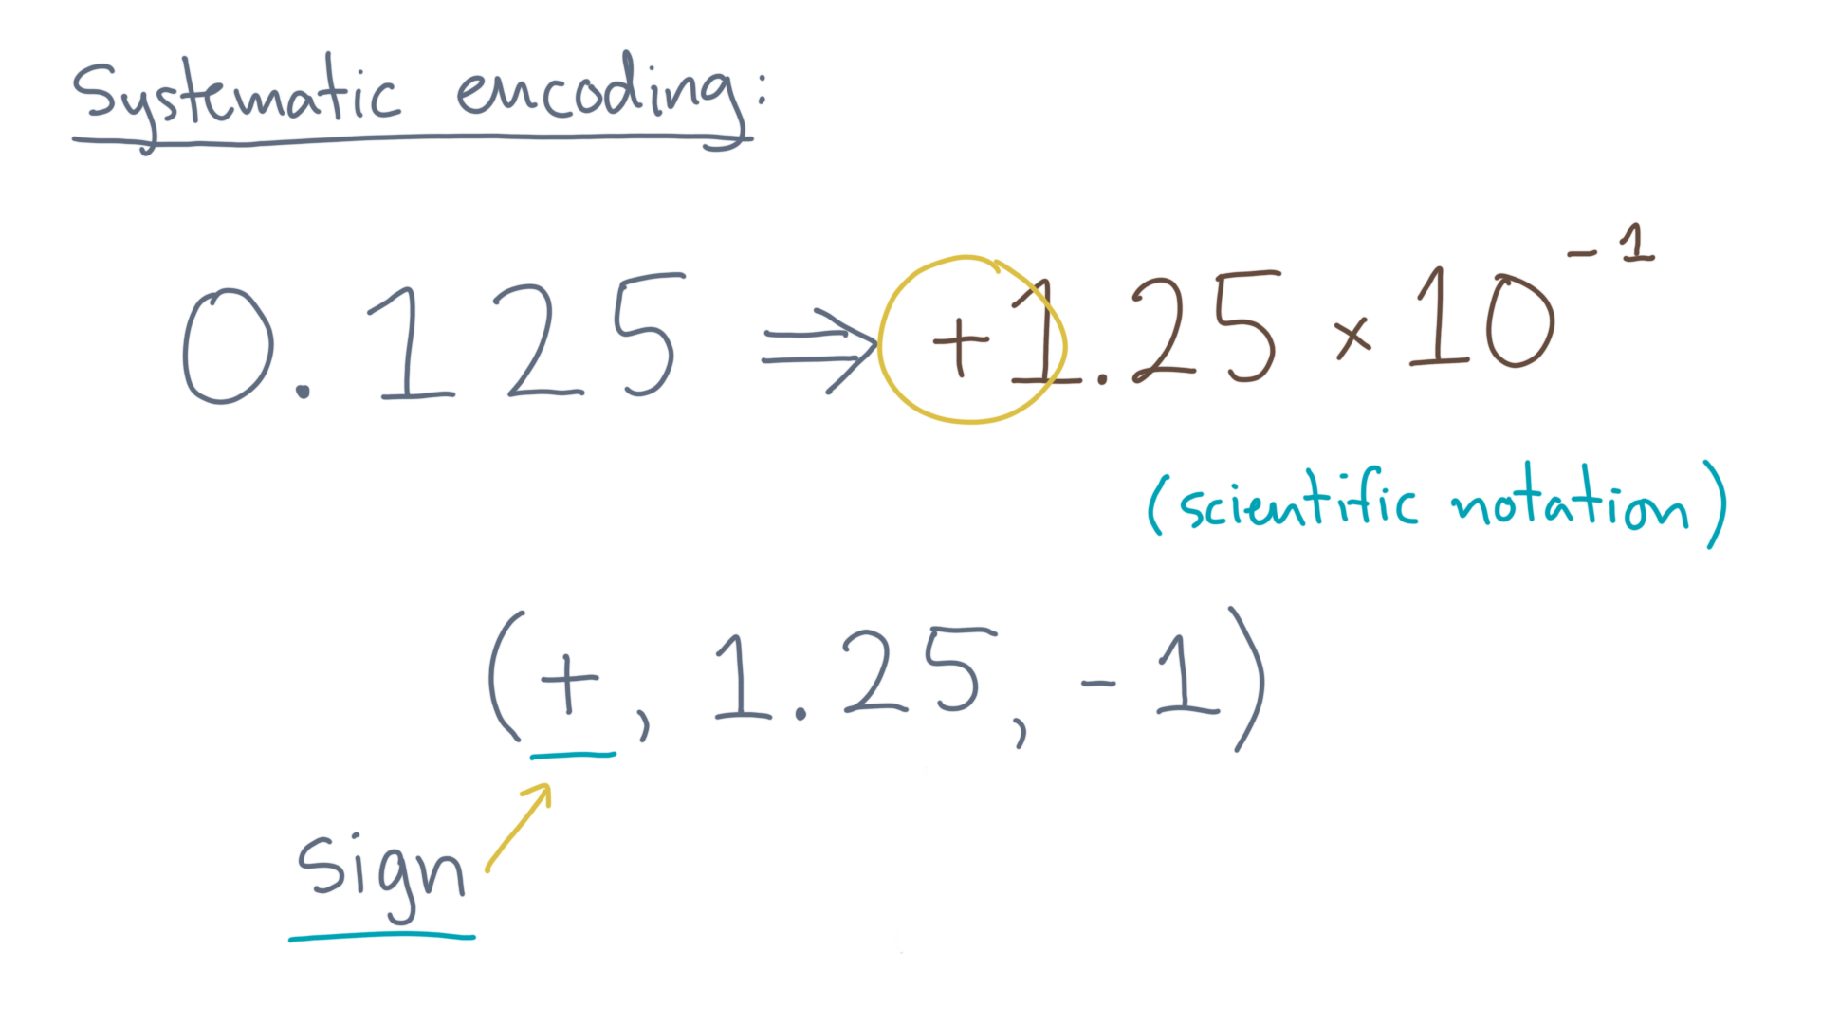
Notes:
Here, the value is positive so the sign component is also positive.

Slide 18
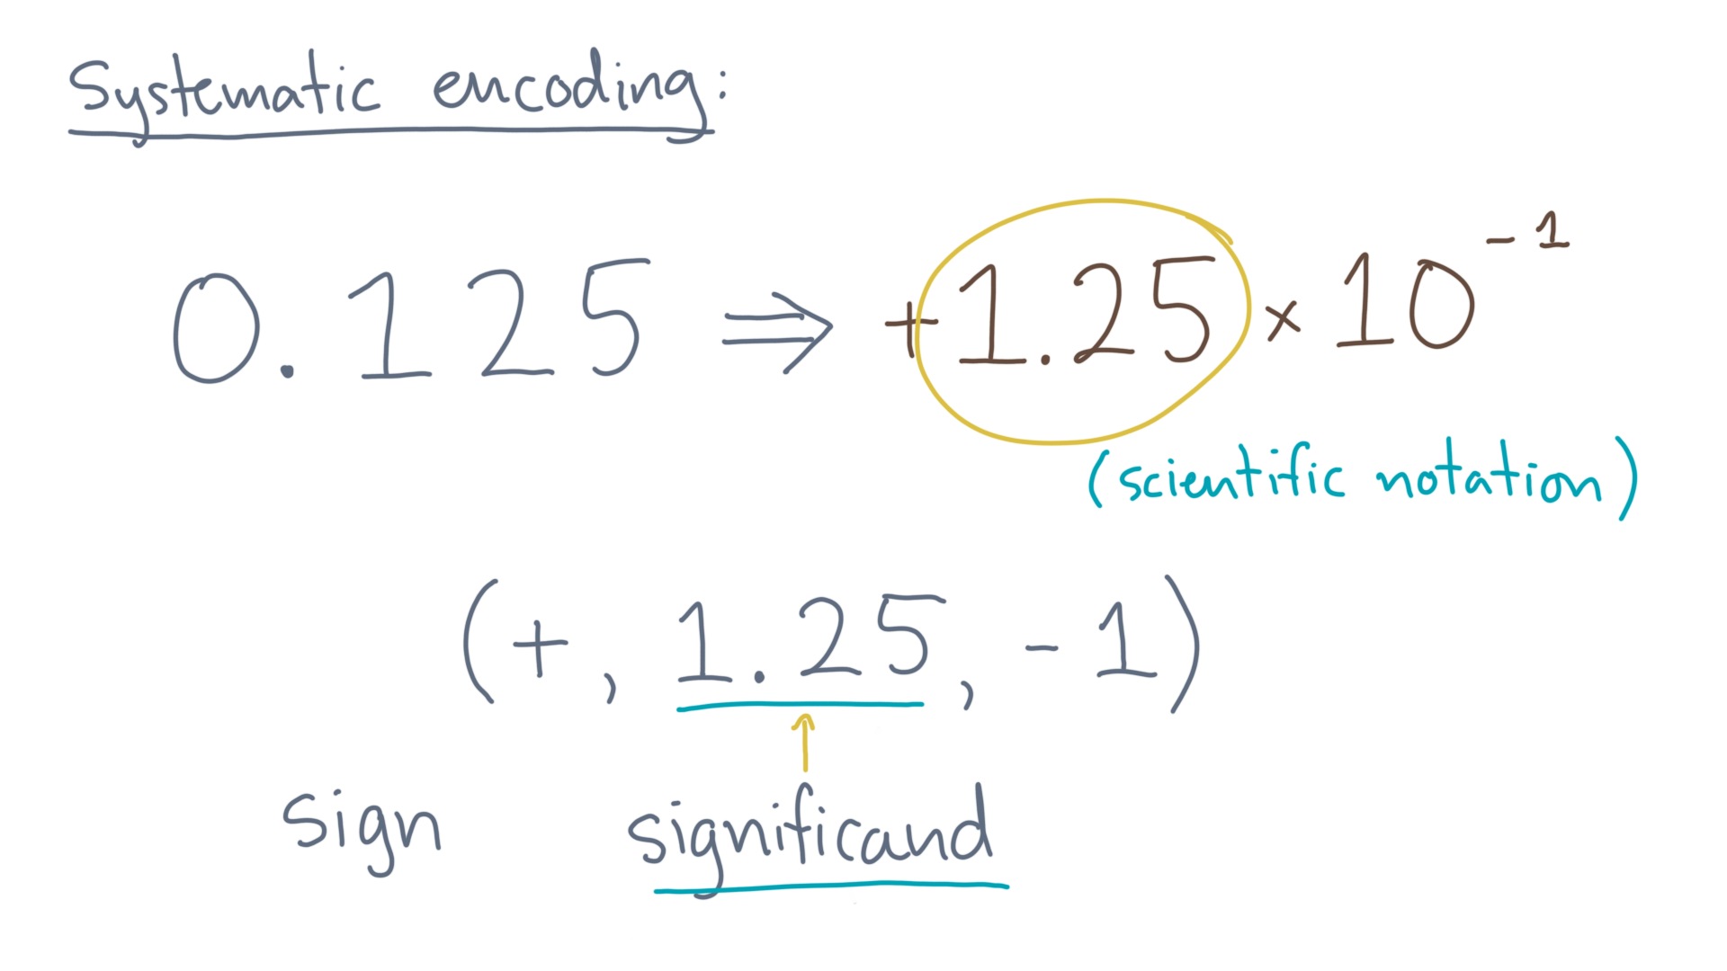
Notes:
Next, there is the *significand*.
That’s the base value, which is 1.25 here.

Slide 19
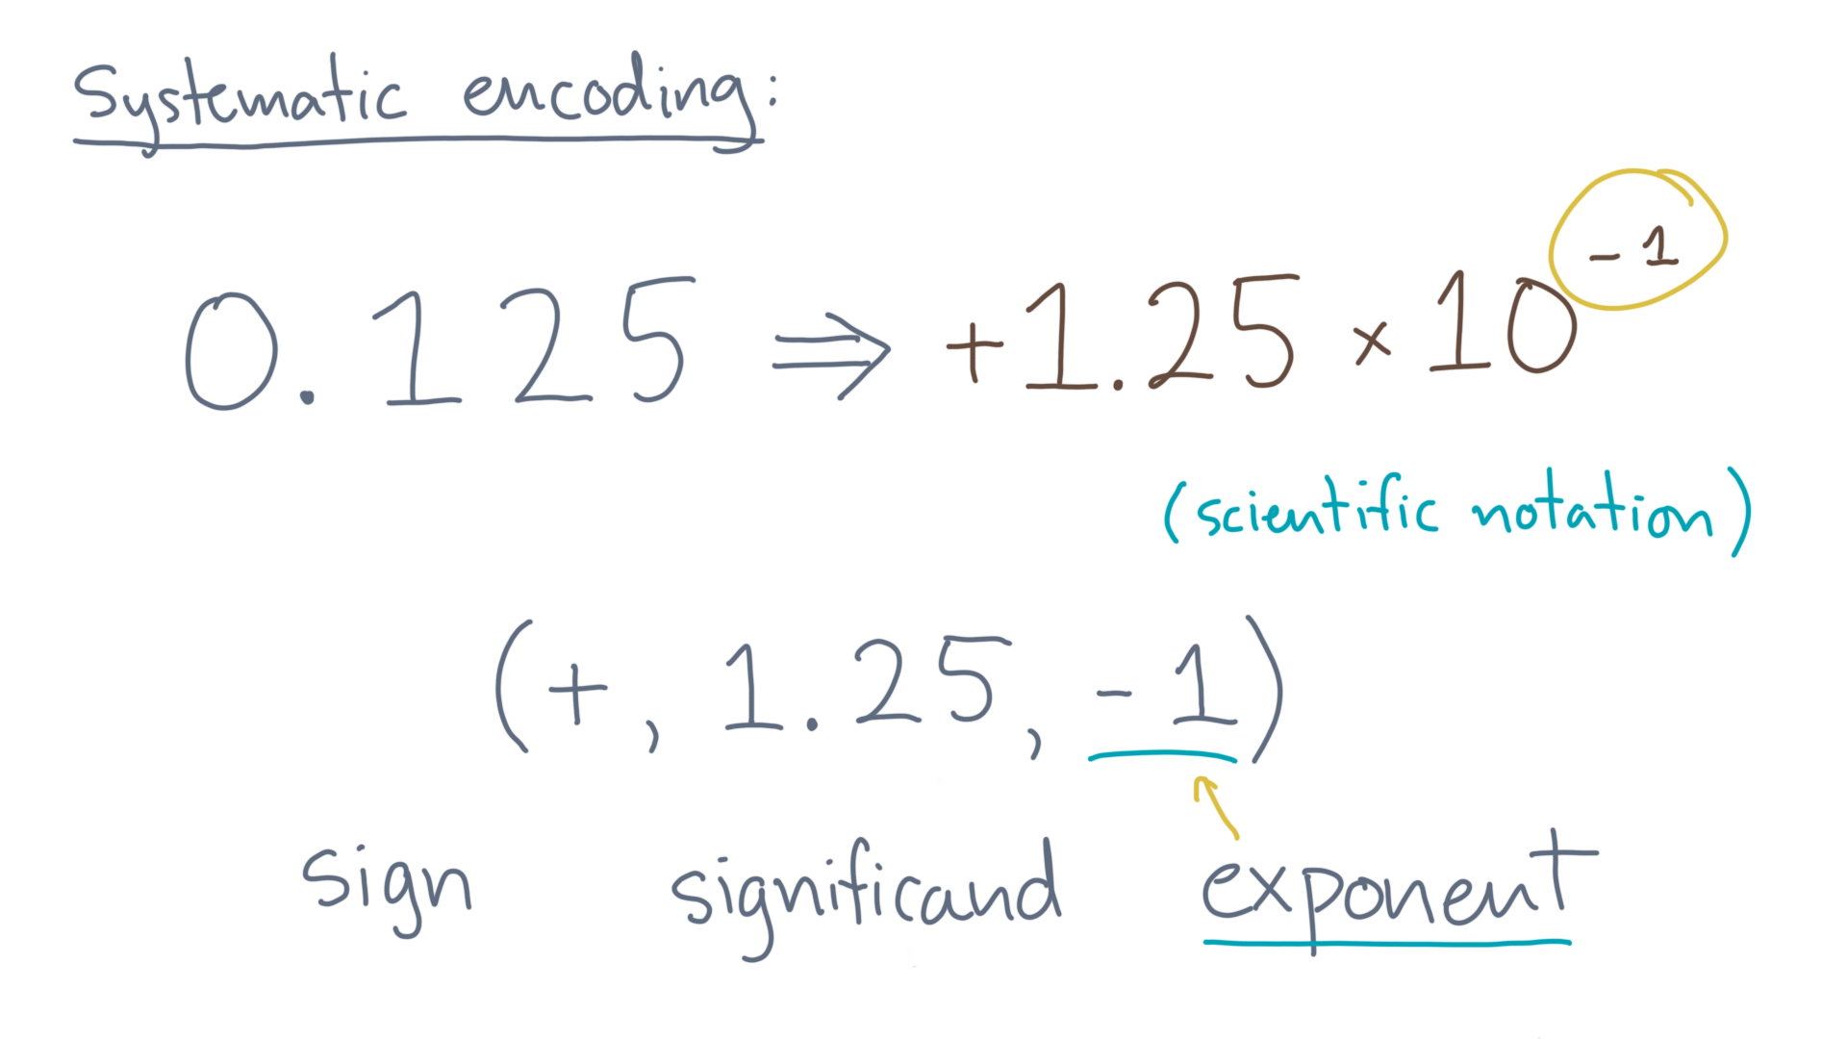
Notes:
Lastly, there’s the *exponent*.
Assuming a particular base, such as ten in this case, you would record the exponent value of minus 1 as the last part of the tuple.

Slide 20
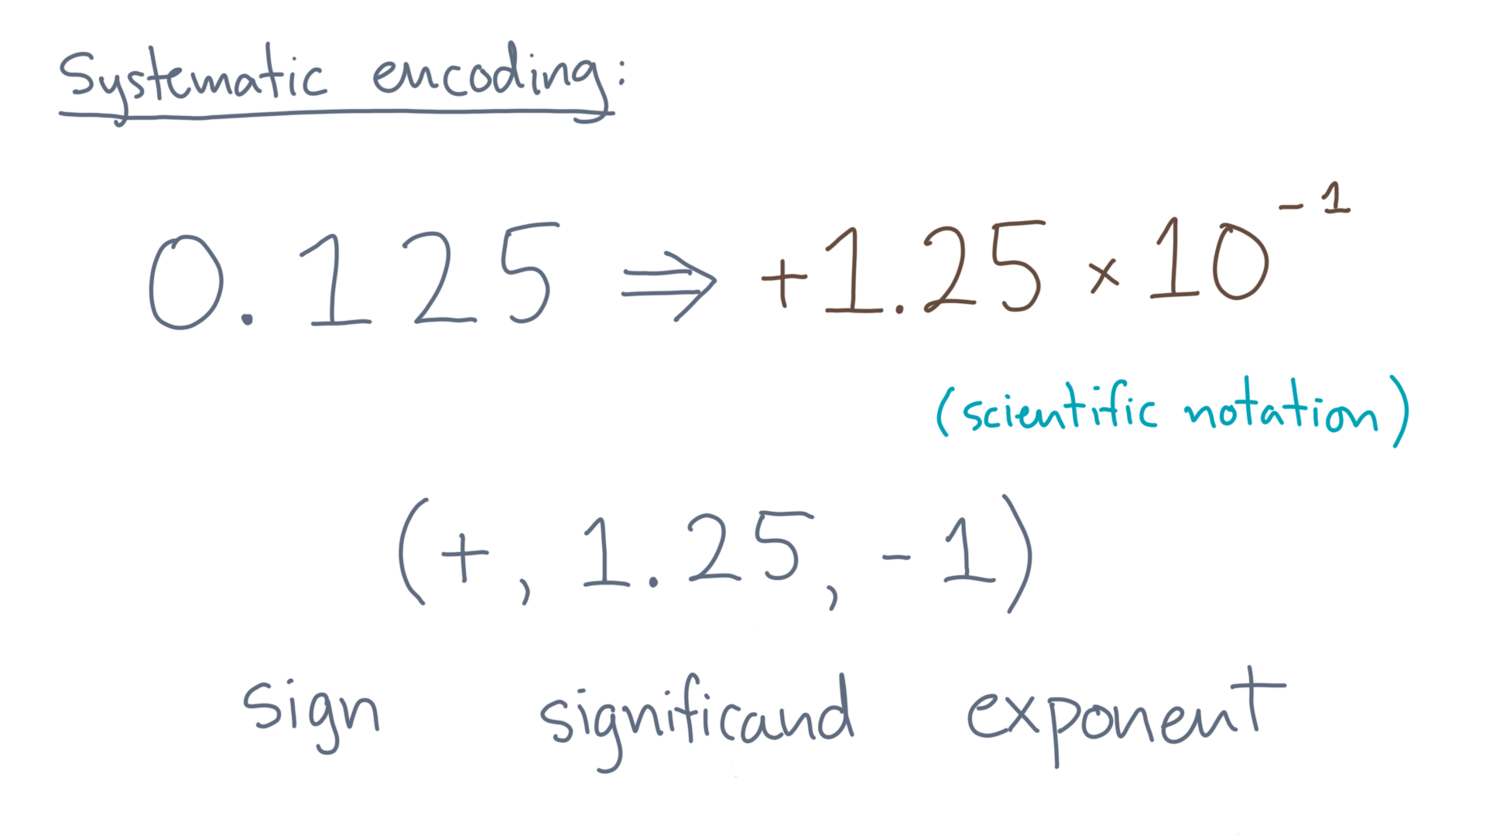
Notes:
In summary, you can take any real number write it in scientific notation, and record the result systematically as a tuple with a sign, significand, and exponent.

Slide 21
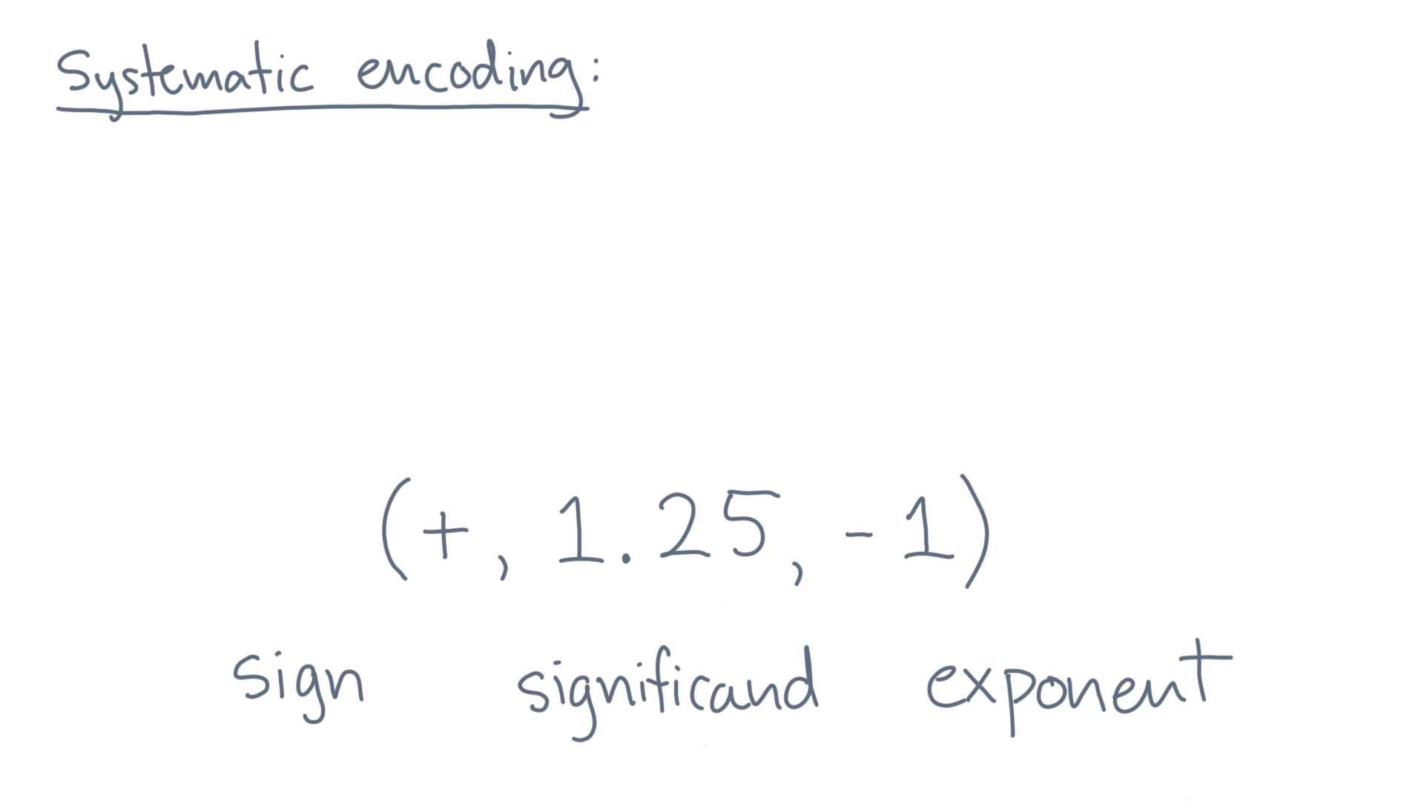
Notes:
On a computer, we will usually use a fixed-size representation of this tuple.

Slide 22
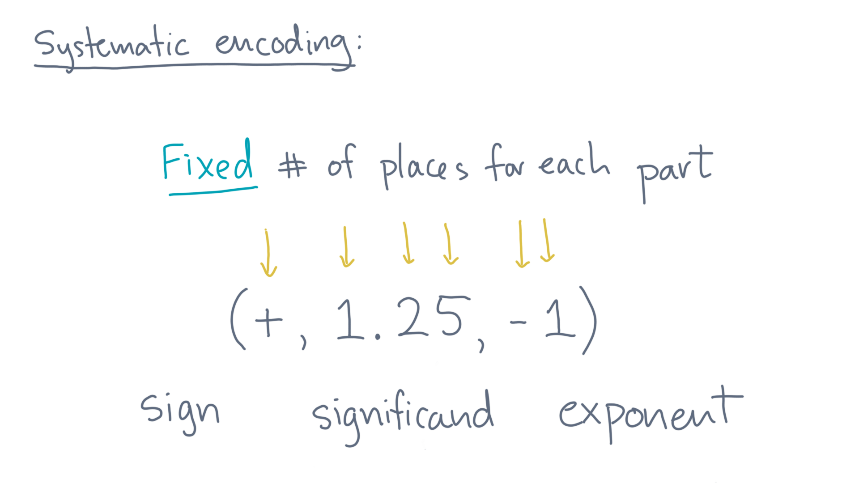
Notes:
For instance, there might be one location for the sign.
Some number of places for the significand.
And a signed integer with a certain number of digits for the exponent.

Slide 23
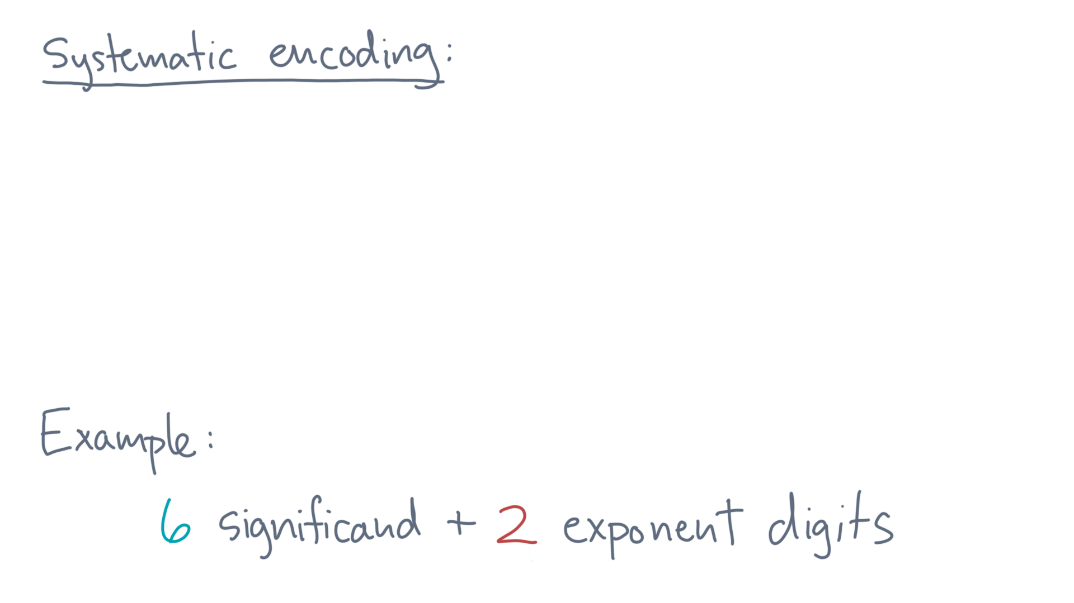
Notes:
Let’s consider an example.
Suppose you allow at most 6 digits for the significand and 2 digits, plus the sign, for the exponent.

Slide 24
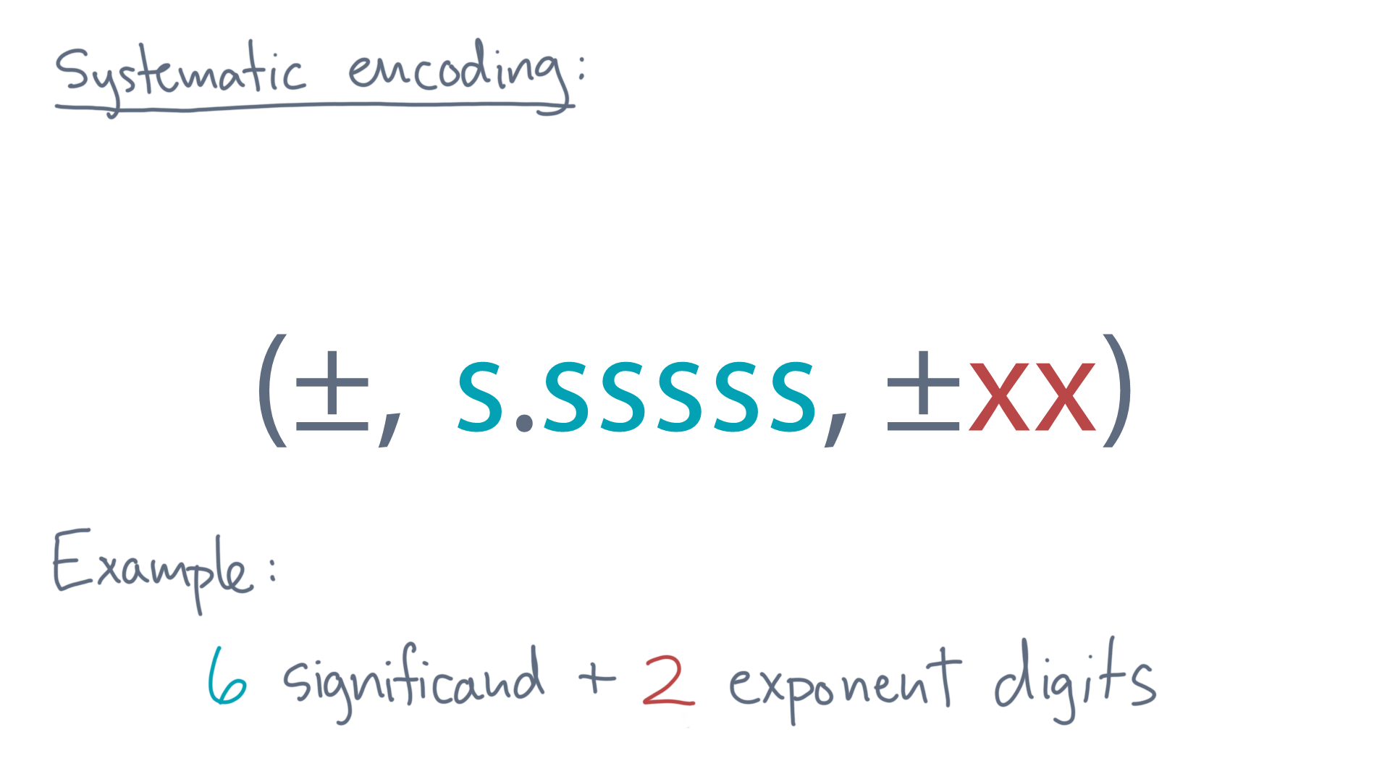
Notes:
Then any value will have this form.

Slide 25
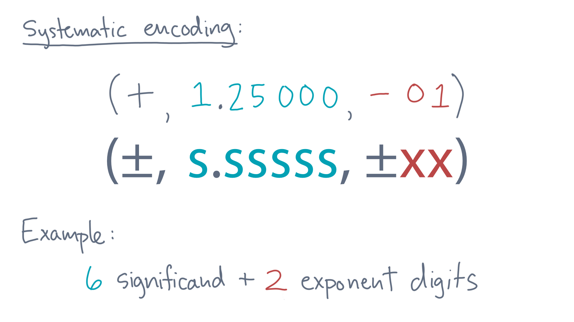
Notes:
Our 0.125 example, for instance, would look like this:
A plus for the sign, 1.25000 for the significand, and minus 0-1 for the exponent.

Slide 26
Notes:
To recap, our goal was to encode numbers with fractional parts in a systematic way, using a fixed-size encoding.
Our idea is to use a floating-point encoding, which we can represent abstractly by a tuple consisting of a sign, significand, and exponent.
And we will use a fixed number of places for each of these components, thereby meeting our goal.

